Slide 1



SMTP Gatewaying Across Delay Tolerant Networks
Sponsored By NASA JPL

Slide 2
Our Team
Leigh Torgerson (JPL)
Liaison
Manveen Kaur
Faculty Advisor
Student Team
Lance Batac
Brian Contreras
Adrian Flores Aquino
Jiahao Li
Sophia Liwag
Nathan Luu
Nicholas Martin
Antonio Ortega
Anderson Peña Reyes
Ryan Torrez
Jilei Zou

Slide 3
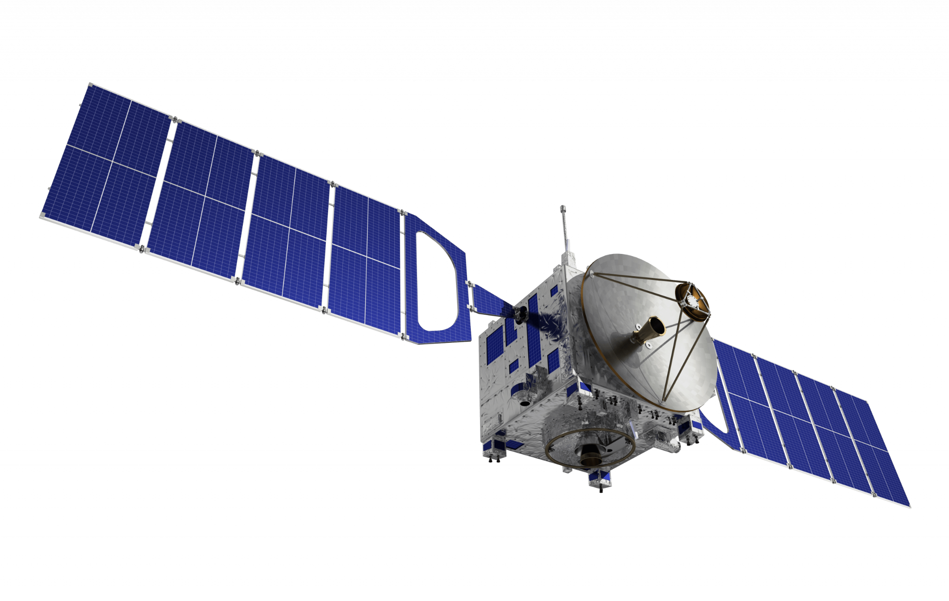
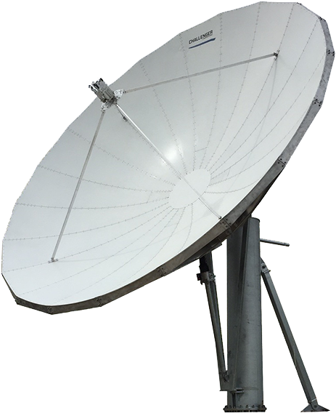

Table of Contents
2
Approach
1
Introduction
3
Conclusion

Slide 4
Introduction

Slide 5


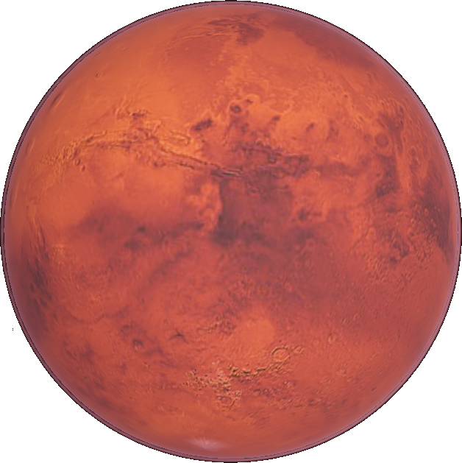
Objective
Build a prototype interplanetary email system using Delay Tolerant Networking to send email between nodes on Earth and nodes on a celestial body

Slide 6
Motivation
Deep space communications has characteristics that make traditional protocols of the TCP/IP suite unworkable
Significant signal attenuation
Highly variable delays
Punctuated connectivity
Lack of continuous end-to-end paths
Long round-trip times
Up to 40 minutes RTT
Notes:
Fun Fact: It takes light 3 minutes to get to mars from earth at closest approach, and around 23 minutes at their farthest!

Slide 7
Motivation
Email architecture is tightly dependent on the TCP/IP suite and is unlikely to significantly change
TCP/IP is expected to be used locally on worlds
Challenge is to adapt email architecture to work between worlds

Slide 8
How DTN Helps
Store and forwarding: main idea behind delay-tolerant networking (DTN)
DTN is implemented at the bundle layer, main protocol is bundle protocol (BP)
Application
Application
Bundle
Common to all DTN nodes
Transport (TCP)
Transport
Common to all Internet nodes
Network (IP)
Network
Specific to each DTN node
Link
Link
Specific to each Internet node
Physical
Physical
Internet Protocols
DTN Protocols

Slide 9
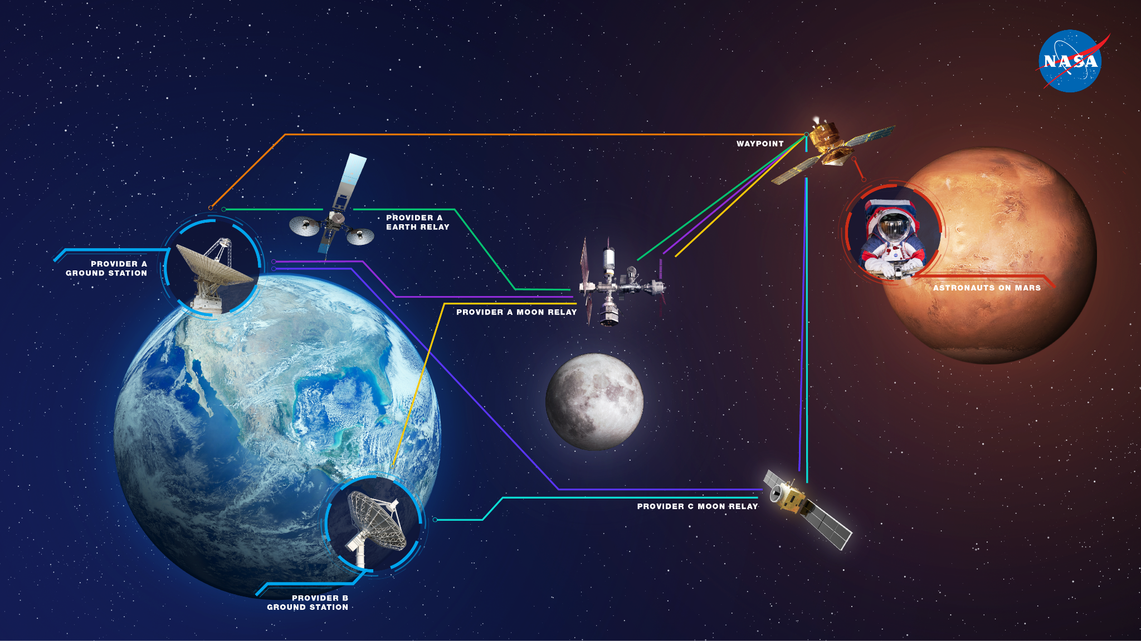
Store and Forward Model
Shift responsibility from only the ends to the rest of the network
Hand the data you want to deliver over to a node closer to your destination
That node will hold on to your data until another node is in position and ready to receive it.
This process happens until reaching the destination.
Picture: Courtesy of Nasa

Slide 10
Approach

Slide 11
Software Solution
SMTP Environment
Non SMTP Environment
SMTP Environment
GW
GW
World A Internet
Deep Space
World B Internet
SMTP gatewaying, but not so extreme as to have an entirely different mail format and protocol
Freeze the SMTP transaction at the sending world and thaw it at the receiving world
Ideally handled with the application/batch-SMTP media type [RFC2442]

Slide 12
Gateway from SMTP -> DTN
Bundle
MAIL FROM:<> RCPT TO:<> DATA
[Payload]
Compress
Compressed Data
Primary Block
BIB Block
DTPC Data Item
Return-Path:<>
From:<domain>
...
ADU for DTPC
SMTP server delivers a batch SMTP object as standard input for our software
MIME message as its DATA
Our software compresses the object and uses the underlying DTN Implementation to send the data with Delay Tolerant Payload Conditioning (DTPC) in bundles signed with Bundle Integrity Blocks (BIB) for authenticity

Slide 13
Gateway from DTN -> SMTP
MAIL FROM:<> RCPT TO:<> DATA
Primary Block
BIB Block
DTPC Data Item
Compressed Data
1. Decompress
3. Submit
Return-Path:<>
From:<domain>
...
2. Verify "From" Domains
domain IN IPN 123
Decompress payload and extract ADU to get batch SMTP object
Parse MIME message, remove "Return-Path" if present, and verify source node number is allowed to gateway for domains of "From" addresses
If invalid MIME message or IPN verification fails, don't submit the message

Slide 14
TODO: can have diagram to name the software it uses and what it does. i wouldn't bother talking about stuff like build systems or test frameworks verbally though

Slide 15
Software diagram
This diagram shows the process of how we’ve designed our software to use bundle protocol to send email from Earth to Mars.

Slide 16
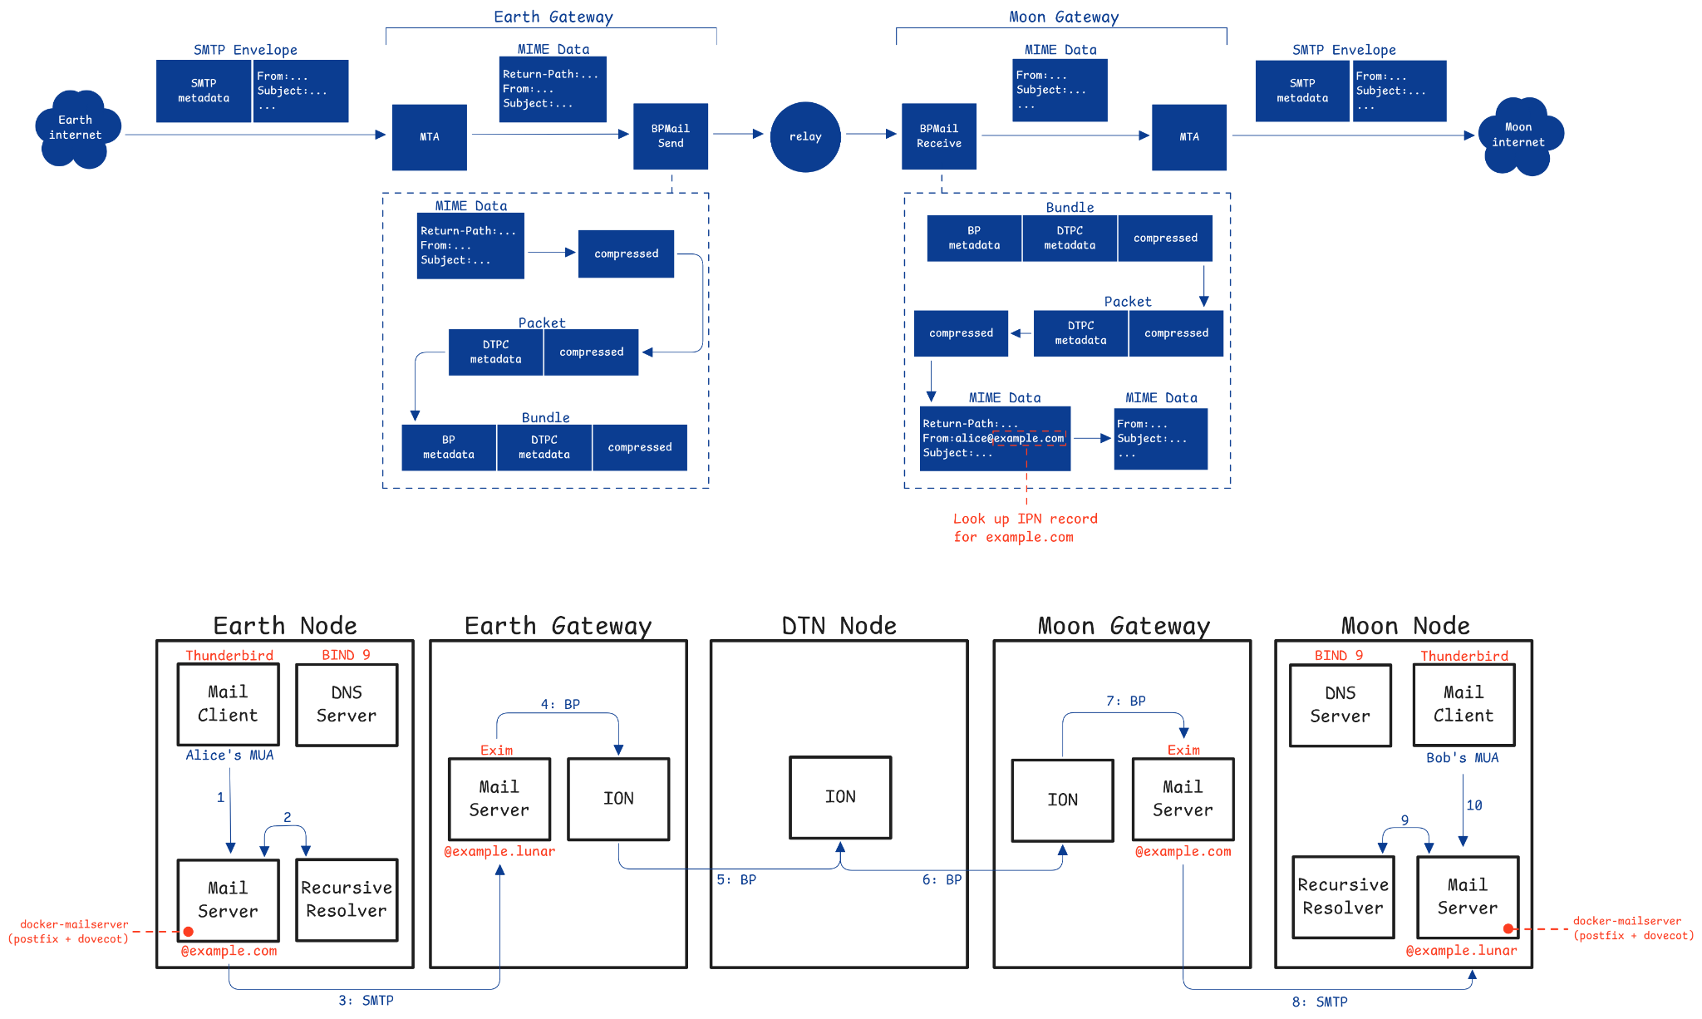
Testbed
Network of five Raspberry Pis
Mars
Mars

Slide 17
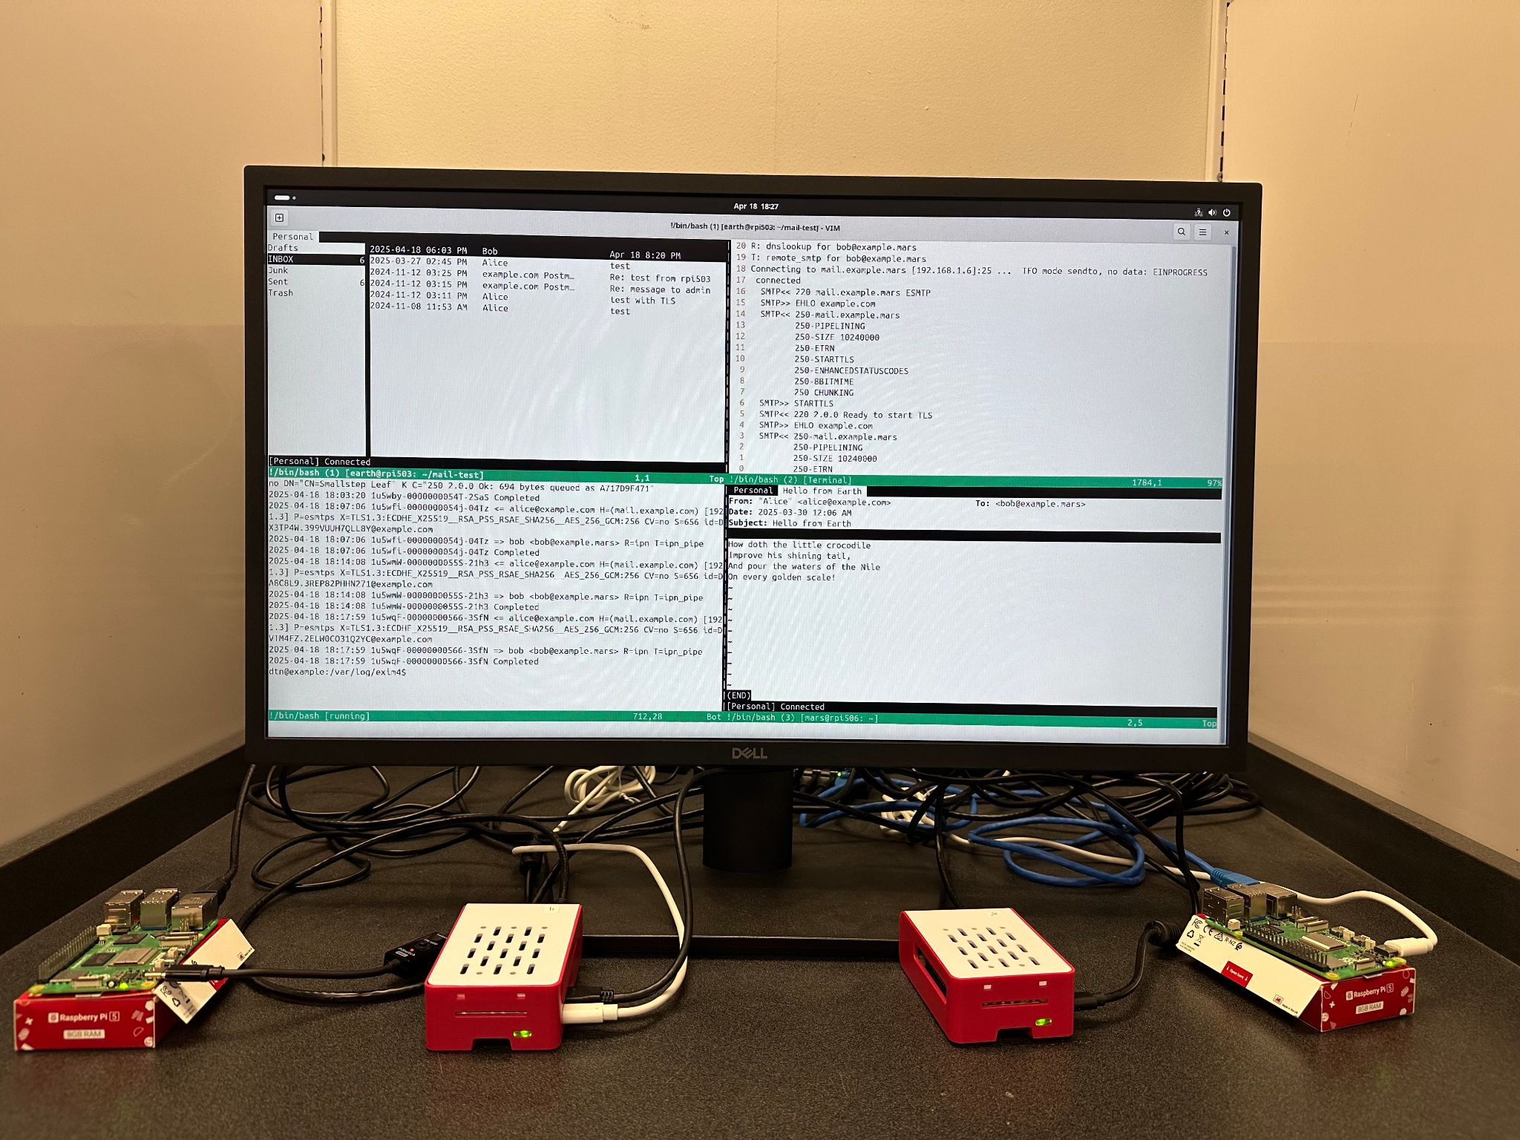
Relay set up
We’ve set up a testbed consisting of Raspberry Pi computers. Ideally, the Pis are meant to simulate a deep space environment between Earth and Mars.

Slide 18
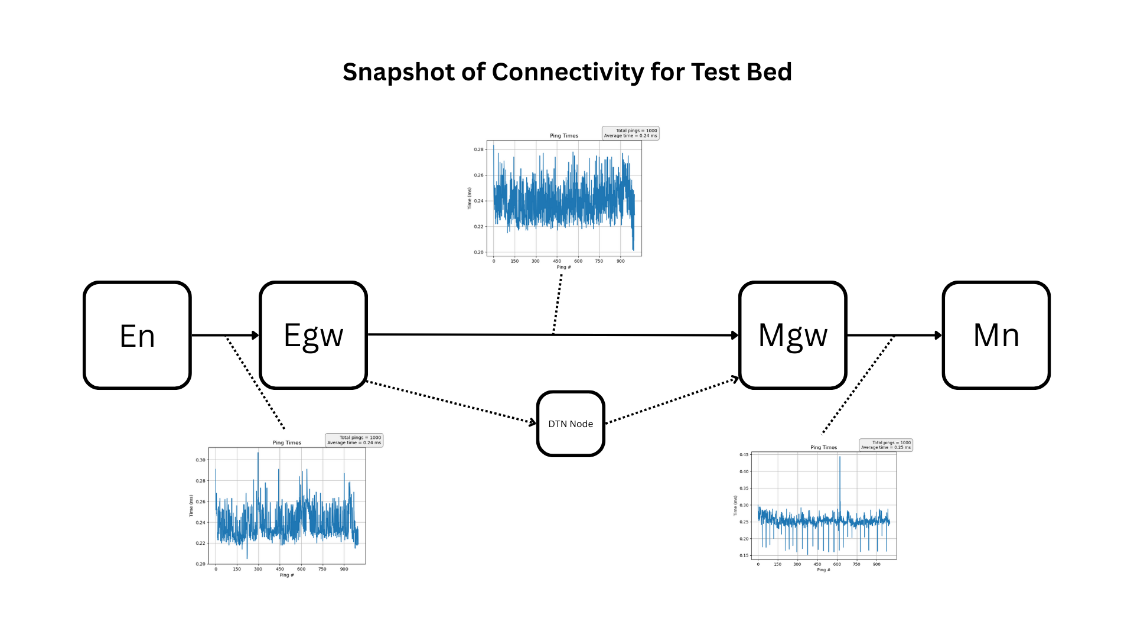
Testing and Validating
The Raspberry Pis that act as non-gateways are configured with ION and email tools (Postfix, Dovecot, Thunderbird).
We simulated space conditions using tc qdisc to inject latency and bandwidth constraints between nodes.
1000 ping tests were run between every neighbor pair:
En ↔ Egw
Egw ↔ Mgw
Mgw ↔ Mn
Each test logged packet loss, delay, and throughput to evaluate reliability.
An end-to-end email was sent from En (Earth Node) to Mn (Mars Node) using bpmailsend and received using bpmailreceive.
Logs were collected and compared at each hop to confirm bundle delivery and validate transmission integrity.

Slide 19
Tools and Technologies
Hardware:
5 Raspberry Pi 5 units configured to simulate Earth and Mars nodes
LAN network switches and USB-to-Ethernet adapters for custom routing
Software:
Postfix & Dovecot: Email server and delivery services
Thunderbird: GUI client for sending/receiving messages
BIND9: Local DNS server with custom MX record resolution
ION (Interplanetary Overlay Network): Core DTN stack for store-and-forward messaging
bpmail: Utilities for gatewaying messages between SMTP and DTN environments
Testing Tools:
Linux Traffic Control (tc qdisc): Injects latency, bandwidth caps, and packet loss
Bash & Python Scripts: Automated testing and log collection
Matplotlib: Data visualization for latency and delivery analysis

Slide 20
Conclusion

Slide 21
Summary
We’ve set out to create a workable means of reliable data transfer in space using DTN protocol through the form of Email from Earth to Mars.
We’ve set up a Test Bed of 5 Pis that allows us to simulate the harsh conditions of deep space
We’ve set up a means of bundling data and sending that data from Earth to Mars where the bundle is received and processed.
We’ve tested the network, making sure all connections are linked and workable.

Slide 22
Future Plans
May
Beyond…
Finalize Documentation
Leave a roadmap for future students to continue our work

Slide 23

References & WIKI
Freed, N., Newman, D., Belissent, J., and M. Hoy, "The Batch SMTP Media Type", RFC 2442, DOI 10.17487/RFC2442, November 1998, https://www.rfc-editor.org/info/rfc2442.
Johnson, S. M., "DNS Resource Records for DTN Overlays", Work in Progress, Internet-Draft, draft-johnson-dns-ipn-cla-07, 1 July 2024, https://datatracker.ietf.org/doc/draft-johnson-dns-ipn-cla/07/.
Johnson, S. M., "An Interplanetary DNS Model", Work in Progress, Internet-Draft, draft-johnson-dtn-interplanetary-dns-04, 20 March 2024, https://datatracker.ietf.org/doc/draft-johnson-dtn-interplanetary-dns/04/.
Klensin, J., "Simple Mail Transfer Protocol", RFC 5321, DOI 10.17487/RFC5321, October 2008, https://www.rfc-editor.org/info/rfc5321.
📲 Scan QR code to access our project GitHub + Wiki

Slide 24
Thank you!

Slide 25
Questions?

